Slide 1

Why Python for AI
Data Science
Machine Learning
Deep Learning
… modern generative AI
Notes:
Welcome to this intro video on WHY PYTHON FOR AI.
Here I list the reasons why python is popular for DS/AI and also provide the github link for elementary python code samples to get started with basics of python as a language, and some of essential libraries like NumPy, PANDAS and visualization tools.

Slide 2
How AI started?
17th century
Ancient Philosophical Roots
Philosophers like Aristotle pondered the possibility of creating intelligent machines.
19th century
Automata
Inventors like Blaise Pascal and Jacques de Vaucanson created automata, which were intricate machines designed to simulate human or animal movements.
20th century
Early Computers
Mathematician Alan Turing, in the 1940s, proposed the idea of a universal machine that could simulate any other machine.

Slide 3
… 3 decades
1956
Dartmouth Conference
term "artificial intelligence" was coined at the Dartmouth Conference in 1956… marked the official beginning of AI as a distinct field.
1950s – 1960s
Early AI Research
Early AI programs like the Logic Theorist and the General Problem Solver demonstrated the potential of computers to perform tasks traditionally associated with human intelligence.
1970s – 1980s
AI Winter
Expectations exceeded what the technology could deliver, and funding for AI research declined.
1980s
Expert Systems
rule-based systems that aimed to mimic human expertise in specific domains.
LISP, PROLOG, CLIPS, Smalltalk, Ada, C and Fortran

Slide 4
Current state
1900s – 2000s
Machine Learning and Neural Networks
the focus shifted toward machine learning approaches and neural networks. Advances in algorithms and computational power.
C, C++, MATLAB, JAVA, Perl, Python, R, SAS
2010s – present
Big Data and Deep Learning
a transformative phase in AI
Python, Scala, Node.js, C++, GO, MATLAB
2024
Current Landscape:
Today, AI is a pervasive part of modern technology, influencing various industries such as healthcare, finance, transportation, and entertainment.
Python – emerging as dominant language

Slide 5
Why python is so popular lang in AI?
Extensive Libraries and Frameworks:
Python boasts rich libraries and frameworks specifically designed for AI and ML. TensorFlow, PyTorch, scikit-learn, and Keras, providing powerful tools for building and deploying machine learning models.
Community Support and Documentation:
Python has a vast and active community of developers contributing to AI and ML projects.
Versatility and Readability:
Python's syntax is clear, concise, and readable, making it an ideal language for beginners and experts alike.

Slide 6

… more reasons
Integration Capabilities
Python seamlessly integrates with other languages and technologies, facilitating the incorporation of AI and ML into existing systems.
Open Source and Free
Python is an open-source language, which means it's freely available, and users can access, modify, and distribute its source code.
Large Ecosystem
Beyond AI and ML-specific libraries, Python offers a vast ecosystem of general-purpose libraries.

Slide 7

And this too…
Ease of Learning
Python's simplicity and readability contribute to its reputation as an easy-to-learn language.
Scalability
Python is scalable, allowing developers to start with small-scale projects and scale up as needed.

Slide 8
Components stack for classical MLs (Python)
Python core (lang, data structures, plotting etc)
NumPy, statistics, maths
SciPy – stats and maths
PANDAS, data handling, plotting
SCIKIT LEARN (sklearn) for Machine leaning
3rd party packages for plots, various other purposes
Pre-reads PDFs, and python code provided in the github repo.
Link in the description section

Slide 9
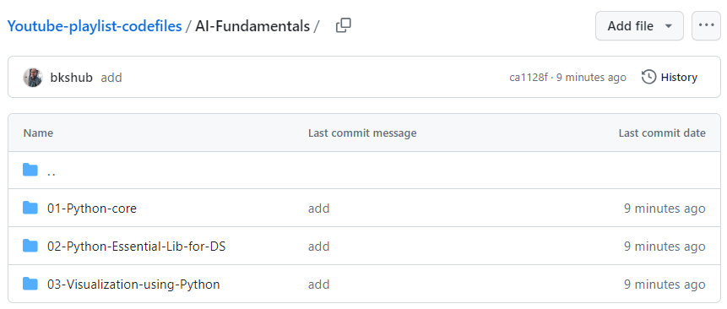


Github repo for the python code files
https://github.com/gridflowai/Youtube-playlist-codefiles/tree/ca1128fed4e3c29a77bfdae0cfc19eabde0b8f28/AI-Fundamentals

Slide 10

Thanks !!
Happy Learning

